Slide 1
CHATBOT
Under the guidance of Dr. N. Arivazhagan
Project by
- Shweta Rajan Nambissan RA1911033010120 - M1
- Unnati Mishra RA1911033010114 - M1

Slide 2
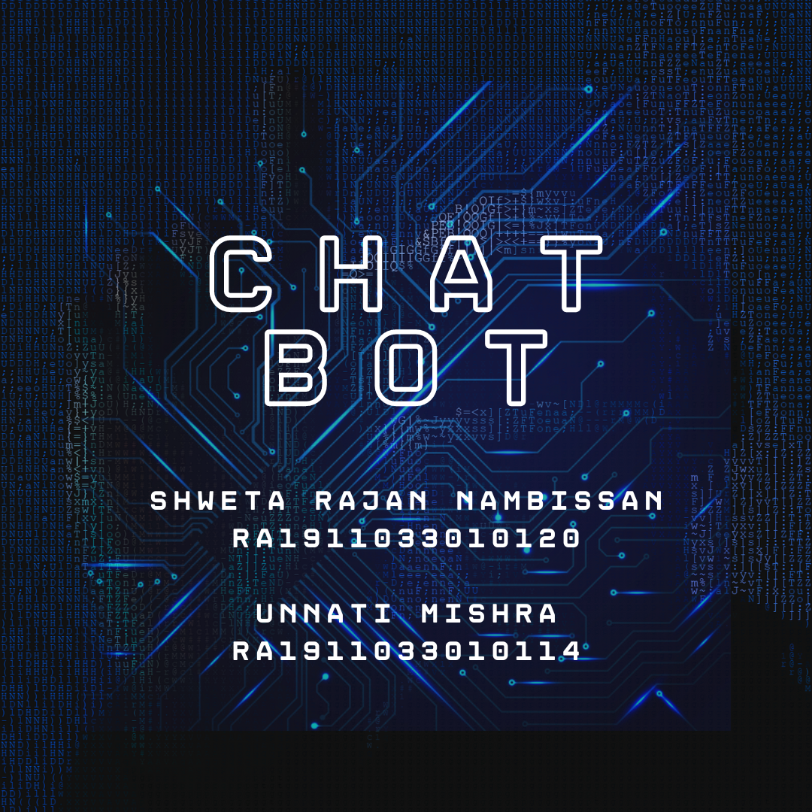

Slide 3
Abstract
A chatbot is AI computer software that can act as a conversation through textual or auditory methods. The core of chatbots analyses a customer’s data using the artificial intelligence which integrates the response with them. Different tasks can be replaced with AI-powered bots as they are much more powerful—and are capable of performing multiple tasks at once. Machine Learning techniques are basically used in the process of understanding the input that we get from the user and replying to the user.
Natural language processing allows a bot to have a conversation as naturally as possible. The ideal interaction between user and chatbot is a balanced mix of Innovative technology and human Intervention

Slide 4
Introduction
A chatbot can conduct smart conversation—either via text or voice. They are armed with machine learning which can interact with humans and become increasingly agile with each interaction. It recognizes using pattern matching, user input as well to access information to provide a predefined acknowledgment. In dialog systems they are used for numerous practical intends comprising information acquisition or customer service. Keywords are scanned with the input in simple chatbot and then respond with the most similar matching keywords or patterns from a database while some chatbots use sophisticated. Their applications make the communication between people and services, intensify the experience of customer. To have better customer engagement and operational efficiency they provide companies new opportunities by lowering the cost of customer service.

Slide 5
Objective:
The main objective of a Chatbot is to engage with users where the users are hanging out instead of asking users to download an app or visit a website to engage with your service/business. Chatbots also boost operational efficiency and bring cost savings to businesses while offering convenience and added services to internal employees and external customers.

Slide 6
Problem Statement and Solution
Managing healthcare and issues is a tedious task for healthcare staff including hospitals and healthcare centers. People find it demure to approach doctor in terms of healthcare. Speaking to a doctor can become shy for some people. Also, people from rural areas find it difficult and time consuming to consult a doctor. A healthcare chatbot can come handy and effective in such situations. Domains where healthcare chatbot can become effective is
People find it easy to look for a solution rather than sharing their problems to a doctor at the first go
Easy and less time consuming
Comfort from the place of your choice

Slide 7
Approach
The chat-bot will be built using natural language processing.
This chatbot is a natural language-based human-computer communication system.
As a result, a person can converse naturally with a machine or system. The chatbot must be able to converse with the user and comprehend what they are saying.

Slide 8
Motivation
The majority of chatbot users in the survey reported their main motivation for using chatbots was the effective and efficient accomplishment of productivity tasks. Participants typically reported using chatbots to obtain assistance or information more easily and precisely. One of the key motivation of chatbot building came from the mental health sector where access to mental health support is often difficult whether it be excessive waiting lists, costs or approaching the support in the first place. Michiel Rauws and Eugene Bann launched their X2AI chatbot in 2014.
“X2AI describes its bots as therapeutic assistants, which means that they offer help and support rather than treatment.” Whereas a traditional counsellor monitors their patient’s body language and tone this chatbot detects patterns.
Patterns are inclusive of phrasing, typing speed, sentence length and other parameters that correlate with a users’ emotional state. Benefits include the fact that some users communicate more freely because it is not a human being on the other end of their conversation.

Slide 9
Requirements
The chatbot should be able to recognize voice and implement the text/message of the user efficiently.
Using the NLP techniques, the bot should be able to analyze the context of a situation.
The chatbot should assist the user in talking critical choices.
The chatbot must be able to identify the intent of the text given by the user and provide accurate solutions for the same.

Slide 10
Requirements Gathering
For the said project a huge, annotated dataset of healthcare comments and queries is needed.
We will need to clean this data for our usage.
We will train multiple NLP classifications models on this dataset and then we will test our models in real world scenario to identify their shortcomings.
The application will be deployed using streamlit. Hence the system conditions should be suitable for the same.

Slide 11
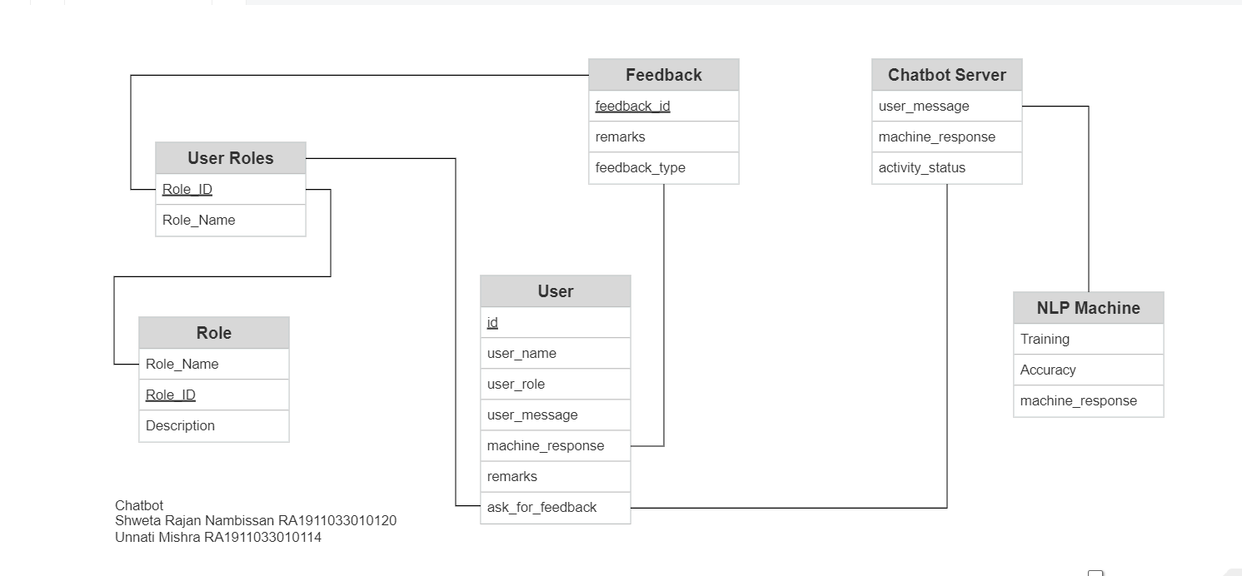
E-R Diagram:

Slide 12
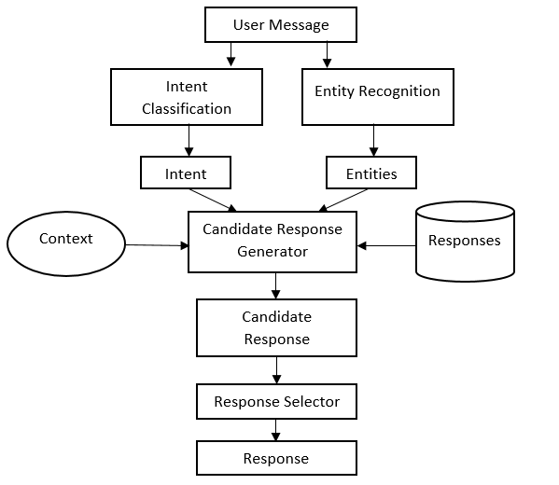
System Architecture Diagram:

Slide 13
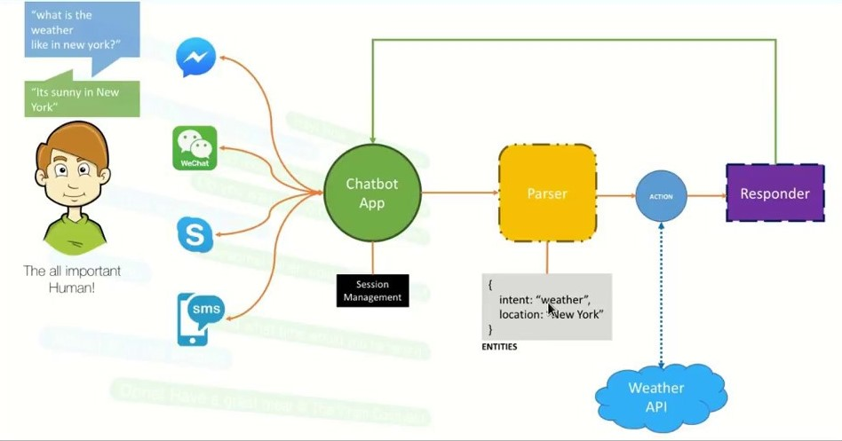

Slide 14
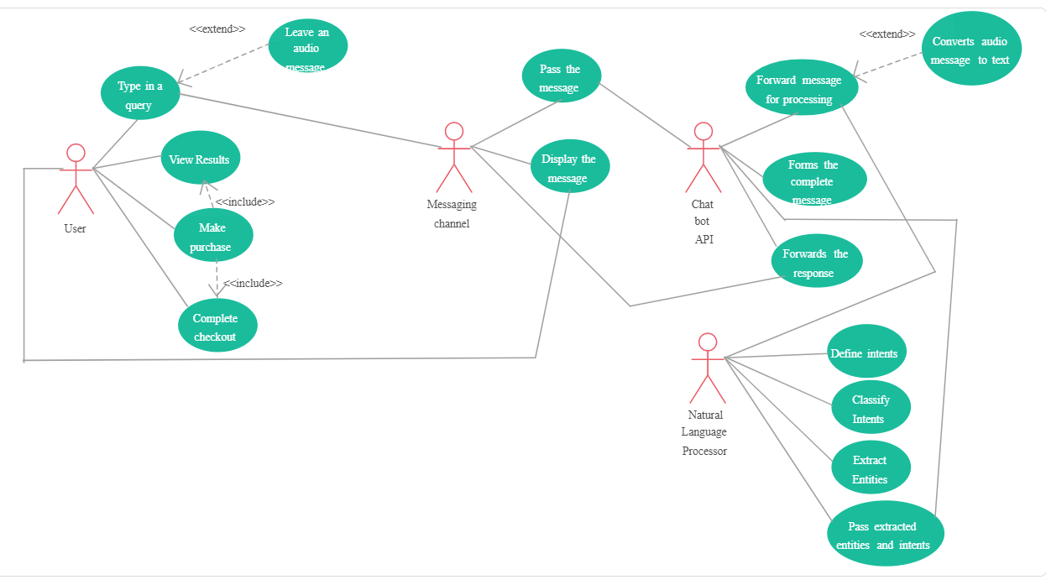
Use-case Diagram:

Slide 15
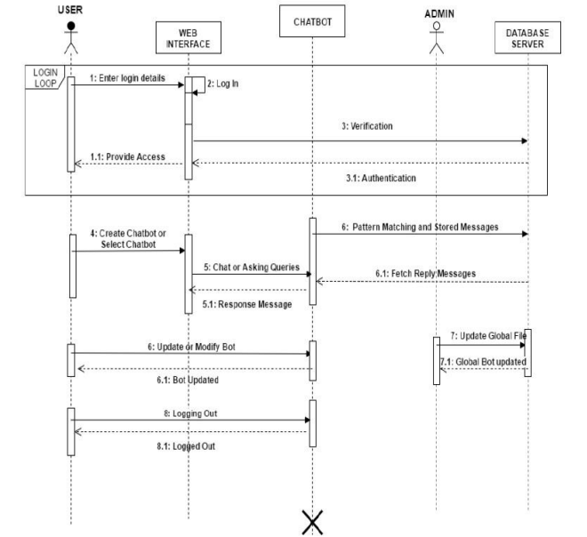
Sequence Diagram:

Slide 16
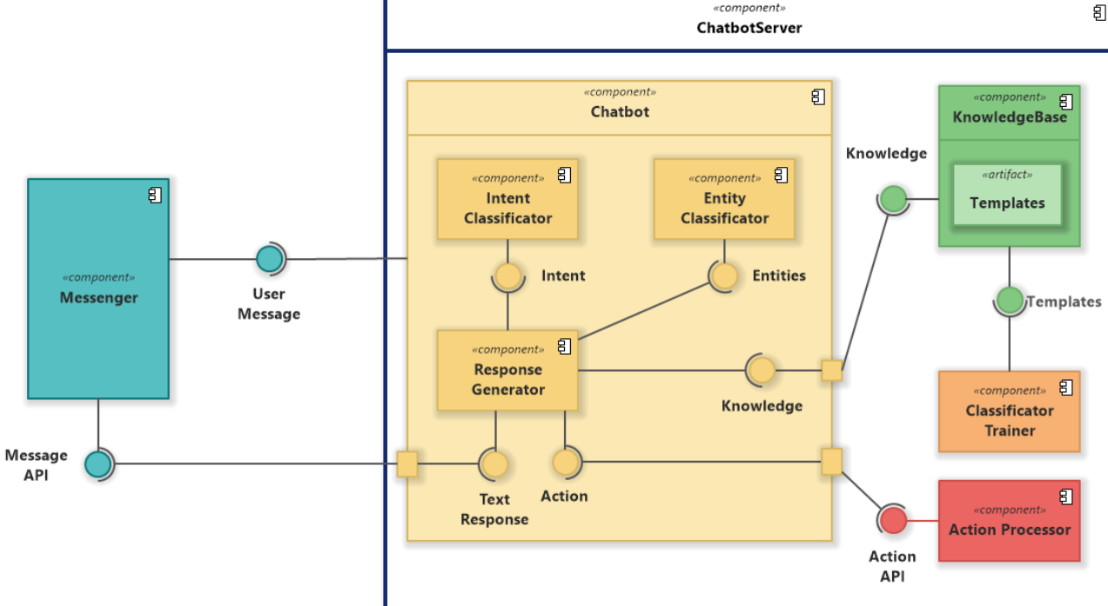
Component Diagram

Slide 17
Limitations
Chatbots Don’t Understand Human Context.
It is one of the significant limitations of chatbots. These chatbots are programmed in a way that they only know what they are taught. They cannot understand humans’ context, and this is a massive gap that can even lead to an angry customer.
.They Don’t Do Customer Retention.
Retaining a customer is a vital part of every organization. It holds more importance than getting new customers. A chatbot is significantly less capable of retaining the customer as it only tries up to a level for which it is programmed.
They Can’t Make Decisions.
Another limitation of chatbots is that they lack decision-making. They don’t have the right know-how to differentiate between the good and the bad.
They Have Zero Research Skills
The harsh reality of chatbots is that they have zero research skills. These bots only have the answers to the available queries; they cannot research new topics on the web.
Chatbots Have No Emotions
Lastly, chatbots have no emotions, and they cannot relate to any low situation. Having no emotions means a chatbot can never establish a connection with the customer, which is crucial for any business’s growth.

Slide 18
Modules Description
Module 1: Model Training Model description:
To collect appropriate data-source
To select an appropriate model
To train the model

Slide 19
Modules Description
Module 2: Frontend Design Model description:
To plan an appropriate design
To select a framework for the frontend
To implement the design

Slide 20
Modules Description
Module 3: Integration of model with frontend Model description:
To plan the functionality of the pages in the design
To integrate the frontend with the model
To test the working of the same

Slide 21
Frameworks and models used
Streamlit
Streamlit is currently one of the most trusted frameworks that is used to deploy a python project
Less code is required for deploying applications, thus letting us focus on the model implementation part
Various online repositories and knowledge from previous projects has made streamlit easy to use for us
The community posts for streamlit is constantly updated and the bugs related to the same are solved seamlessly
Moreover, streamlit does not require callbacks

Slide 22
Frameworks and models used
Decision Tree Classifier
Decision Tree Classifier is a supervised learning algorithm.
As the name suggest, it has a tree structure where internal nodes represent dataset characteristics, leaf nodes the outcome. Note that the branches are basically decision rules.
All the present solutions for a given condition in a problem are shown in the model, thus letting it choose the most appropriate solution.
The node responsible for decisions (decision node) asks a question, and based on the answer i.e. YES or NO, the tree further splits into subtrees.
Moreover, the model is easy to understand.
Decision Tree Classifier shows human thinking capability when making a decision using a tree structure

Slide 23
Comparison of different research papers
Sr. No. | Authors | Problem discussed | Method/ Algorithm/ Tool Used | Results and Limitations
1 | Doshi | To implement a chatbot using Python Chatterbot integrated with Google embedder | Cosine Similarity Model | It involves various algorithms like RASA, Python’s Chatterbot, Cosine Similarity and Google embedder which make it slower
2 | L. Sanchez-Adame, S. Mendoza, J. Urquiza, J. Rodriguez and A. Meneses-Viveros | To study the heuristics of evolving chatbots | NLP | The chatbot is restricted to one language
3 | T. Lalwani, S. Bhalotia, A. Pal, S. Bisen and V. Rathod | Implementation of chatbot using NLP and AI | Lemmatization and POS Tagging Using WordNet | The chatbot simulates human behaviour for generic questions only
4 | S. Ayanouz, B. Abdelhakim and M. Benhmed | A conversational agent for healthcare | NLP, NLU, NSG, ASR | The chatbot provides answers to questions only and no prediction of the disease
5 | E. Kasthuri and S. Balaji | A chatbot that functions as a virtual assistant | Long Short Memory Algorithm | The chatbot functions more like an answer agent rather than guiding or making predictions. Moreover, its contribution in healthcare is negligible.
6 | R. Ravi | A chatbot for teaching and learning process | NLP and Google Design Sprint | The chatbot is dedicated to learning and educational purpose and does not function in an effective manner in healthcare sector
7 | P. Vergadia | A chatbot dedicated to COVID pandemic related queries | Dialogflow | The chatbot is a mere integration of external API
8 | A. S. Miner, L. Laranjo, and A. B. Kocaballi | A chatbot aimed to be corona virus self checker chatbot | NLP | The chatbot is dedicated specifically to allow the user to self-check themselves with corona virus

Slide 24
Results
The project will make use of the trained model and predict the possible disease.
The output will not only predict the disease but also help them get in touch with a doctor from the respected field.

Slide 25
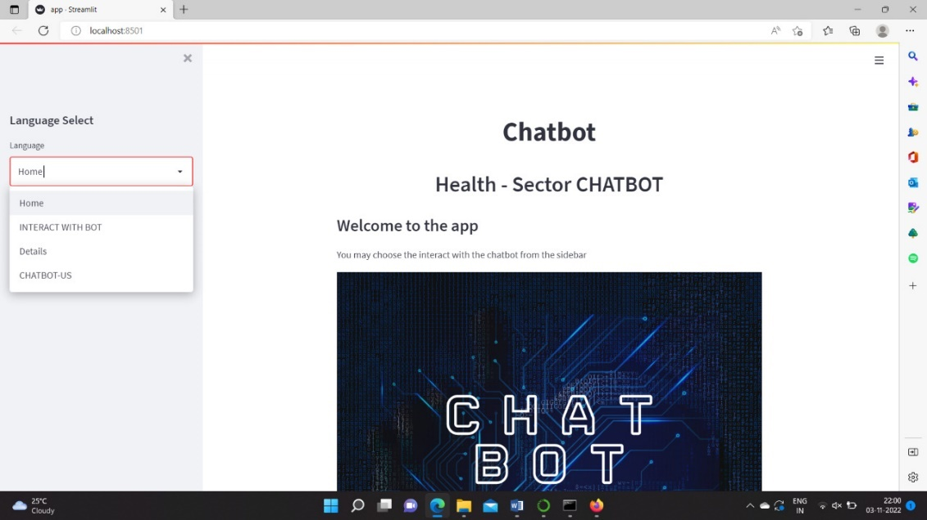
Output Implementation and demo

Slide 26
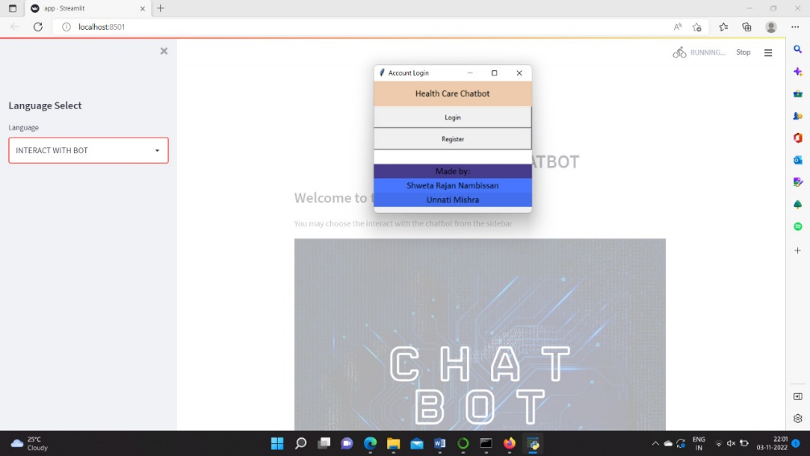
Output Implementation and demo

Slide 27
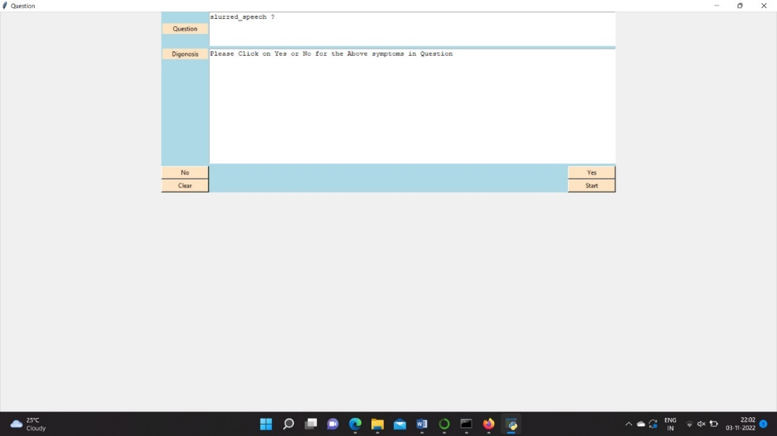
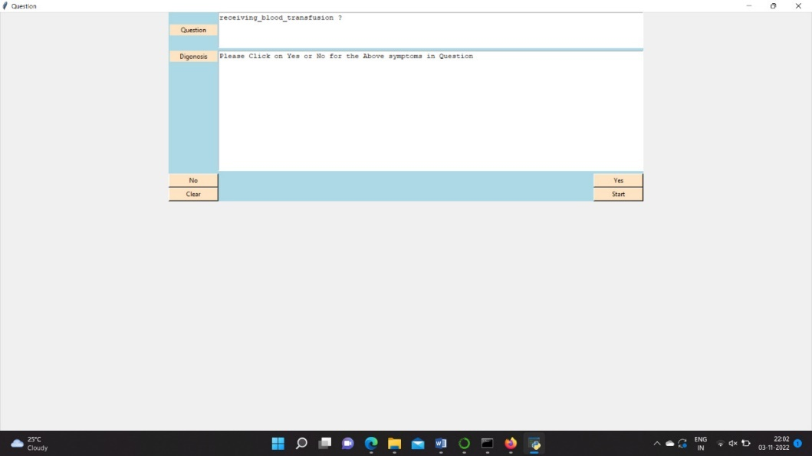
Output Implementation and demo

Slide 28
References
[1]J. Doshi, "Chatbot User Interface for Customer Relationship Management using NLP models", 2021 International Conference on Artificial Intelligence and Machine Vision (AIMV), 2021. Available: 10.1109/aimv53313.2021.9670914
[2]L. Sanchez-Adame, S. Mendoza, J. Urquiza, J. Rodriguez and A. Meneses-Viveros, "Towards a Set of Heuristics for Evaluating Chatbots", IEEE Latin America Transactions, vol. 19, no. 12, pp. 2037-2045, 2021. Available: 10.1109/tla.2021.9480145.
[3]T. Lalwani, S. Bhalotia, A. Pal, S. Bisen and V. Rathod, "Implementation of a Chat Bot System using AI and NLP", International Journal of Innovative Research in Computer Science &amp; Technology, vol. 6, no. 3, pp. 26-30, 2018. Available: 10.21276/ijircst.2018.6.3.2.
[4]S. Ayanouz, B. Abdelhakim and M. Benhmed, "A Smart Chatbot Architecture based NLP and Machine Learning for Health Care Assistance", Proceedings of the 3rd International Conference on Networking, Information Systems &amp; Security, 2020. Available: 10.1145/3386723.3387897
[5]E. Kasthuri and S. Balaji, "Natural language processing and deep learning chatbot using long short term memory algorithm", Materials Today: Proceedings, 2021. Available: 10.1016/j.matpr.2021.04.1
[6]Jia, J. The Study of the Application of a Keywords-based Chatbot System on the Teaching of Foreign Languages. arXiv 2003, arXiv:cs/0310018.
[7]Sojasingarayar, A. Seq2Seq AI Chatbot with Attention Mechanism. Master’s Thesis, Department of Artificial Intelligence, IA School/University-GEMA Group, Boulogne-Billancourt, France, 2020.
[8]Bala, K.; Kumar, M.; Hulawale, S.; Pandita, S. Chat-Bot For College Management System Using A.I. Int. Res. J. Eng. Technol. (IRJET) 2017, 4,4.

Slide 29
References
[9]4.Ayanouz, S.; Abdelhakim, B.A.; Benhmed, M. A Smart Chatbot Architecture based NLP and Machine Learning for Health Care Assistance. In Proceedings of the 3rd International Conference on Networking, Information Systems & Security, Marrakech, Morocco, 31 March–2 April 2020; pp. 1–6. [CrossRef]
[10]Kumar, R.; Ali, M.M. A Review on Chatbot Design and Implementation Techniques. Int. J. Eng. Technol. 2020, 7, 11. [CrossRef]
[11]Cahn, J. CHATBOT: Architecture, Design, & Development. Ph.D. Thesis, University of Pennsylvania, School of Engineering and Applied Science, Philadelphia, PA, USA, 2017.
[12]Okuda, T.; Shoda, S. AI-based Chatbot Service for Financial Industry. FUJITSU Sci. Tech. J. 2018, 54, 5.
[13]Brandtzaeg, P.B.; Følstad, A. Why People Use Chatbots. In Internet Science; Kompatsiaris, I., Cave, J., Satsiou, A., Carle, G., Passani, A., Kontopoulos, E., Diplaris, S., McMillan, D., Eds.; Lecture Notes in Computer Science; Springer International Publishing: Berlin/Heidelberg, Germany, 2017; Volume 10673, pp. 377–392.
[14]Costa, P. Conversing with personal digital assistants: On gender and artificial intelligence. J. Sci. Technol. Arts 2018, 10, 59–72. [CrossRef]
[15]Go, E.; Sundar, S.S. Humanizing chatbots: The effects of visual, identity and conversational cues on humanness perceptions. Comput. Hum. Behav. 2019, 97, 304–316. [CrossRef]

